Slide 2
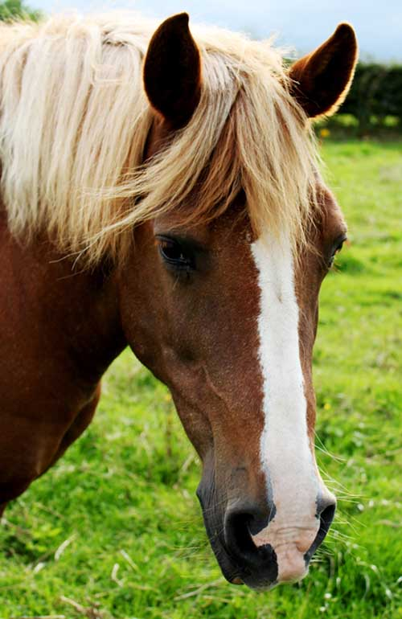
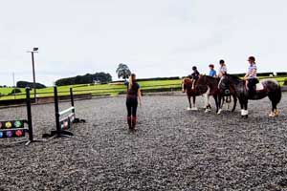
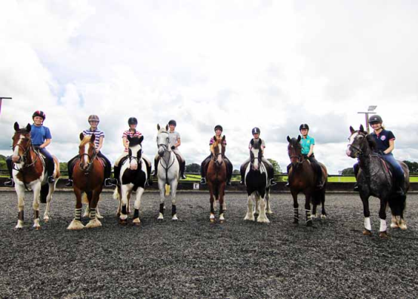
Tuesday 3rd April
Poplars farm visit – This will include a 30minure beginners lesson, a grooming session with the horses in the stables and a rosette! (£15.00)
This trip is optional and children will be given the opportunity to remain at Footprints with Footprint’s staff and play with the many activities available.
For anyone wanting to take part in the trip, Footprints will be at reduced charge for this day: Full day-£15.00 School day- £12.00

Slide 3
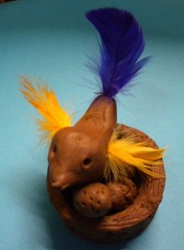
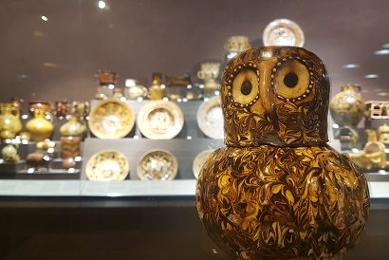
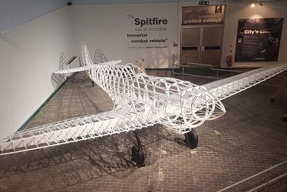
Wednesday 4th April
Potteries Museum – This will include a scavenger hunt where children will be challenged to find different items throughout the museum. Children will be join an art workshop in order to make a clay chick with feathers to take home! (£2.50)

Slide 4
Thursday 5th April
Street Dance Workshop- back by popular demand… Qualified dance teacher Miss Wilkinson is back to teach us some more moves! Children will be given the opportunity to learn a fantastic new routine. Watch out for our dance video on Twitter!(£2.00)

Slide 5
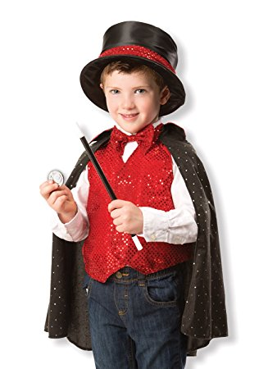
Friday 6th April
Abracadabra Day- This will be a magical day at Footprints! Children will take part in all things enchanting with opportunities to learn new magic tricks, put on magic shows, make a wizards hat and wand, get their face painted and so much more. Watch out for Mr Lowe’s Magical show !

Slide 6
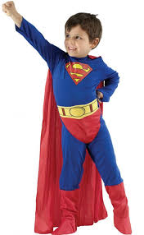
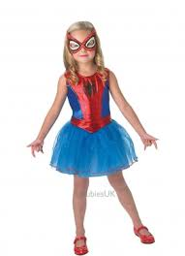
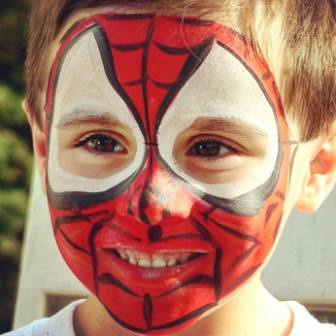
Monday 9th April
Superheroes and Villains Day!-This will include
Face paints
Dressing up
Superhero Challenges and games
Treasure hunts
Competitions and quizzes
Superheroes needed for this super day!

Slide 7
Tuesday 10th April
Poplars farm visit – This will include a 30minure beginners lesson, a grooming session with the horses in the stables and a rosette! (£15.00)
This trip is optional and children will be given the opportunity to remain at Footprints with Footprint’s staff and play with the many activities available.
For anyone wanting to take part in the trip, Footprints will be at reduced charge for this day: Full day-£15.00 School day- £12.00

Slide 8
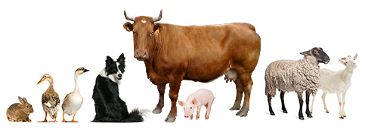
Wednesday 11th April
Amerton Farm- This will include
Entry into Billy’s Farm Barn which includes a large indoor wooden play area with cyber room and large outdoor play area.
Entry Animal Farm Barn which will include a range of activities including lamb or calf bottle feeding, chick hatching, horse grooming and meeting the rabbits.
A tractor and trailer ride! (£5.99)

Slide 9
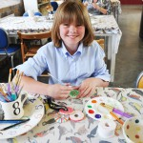
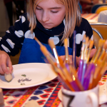
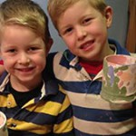
Thursday 12th April
Emma Bridgewater Factory-This includes a guided tour of the amazing Emma Bridgewater factory and a morning in the art workshop where you will get the chance to paint your very own plate to take home! (£8.00)

Slide 10
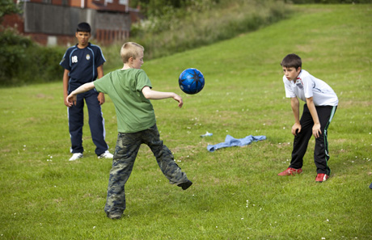
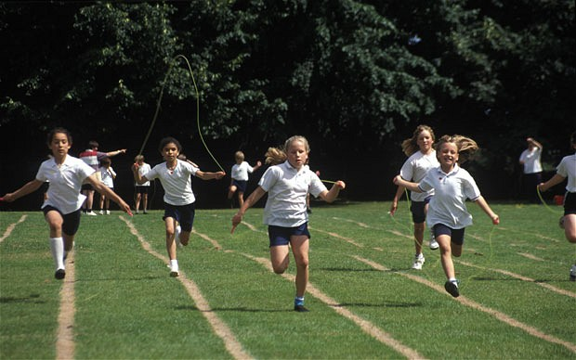
Friday 13th April
Footprints Olympics!!!- Footprints are hosting their very own Easter Olympics!!!
Each team will be given a country and will and be given the opportunity to have their face painted in their team colours.
Teams will then compete in different sports, games and challenges in order to win points!
A special awards ceremony will take place to award our amazing athletes
Assault courses, gymnastics, ball games and races (to name a few!)

Slide 11
We hope to see you there!
Please ask your parents to email: footprints@parkhallacademy.co.uk to ask any questions and pay for any sessions via parent pay.

