Slide 1
Water Safety
Keep safe

Slide 2
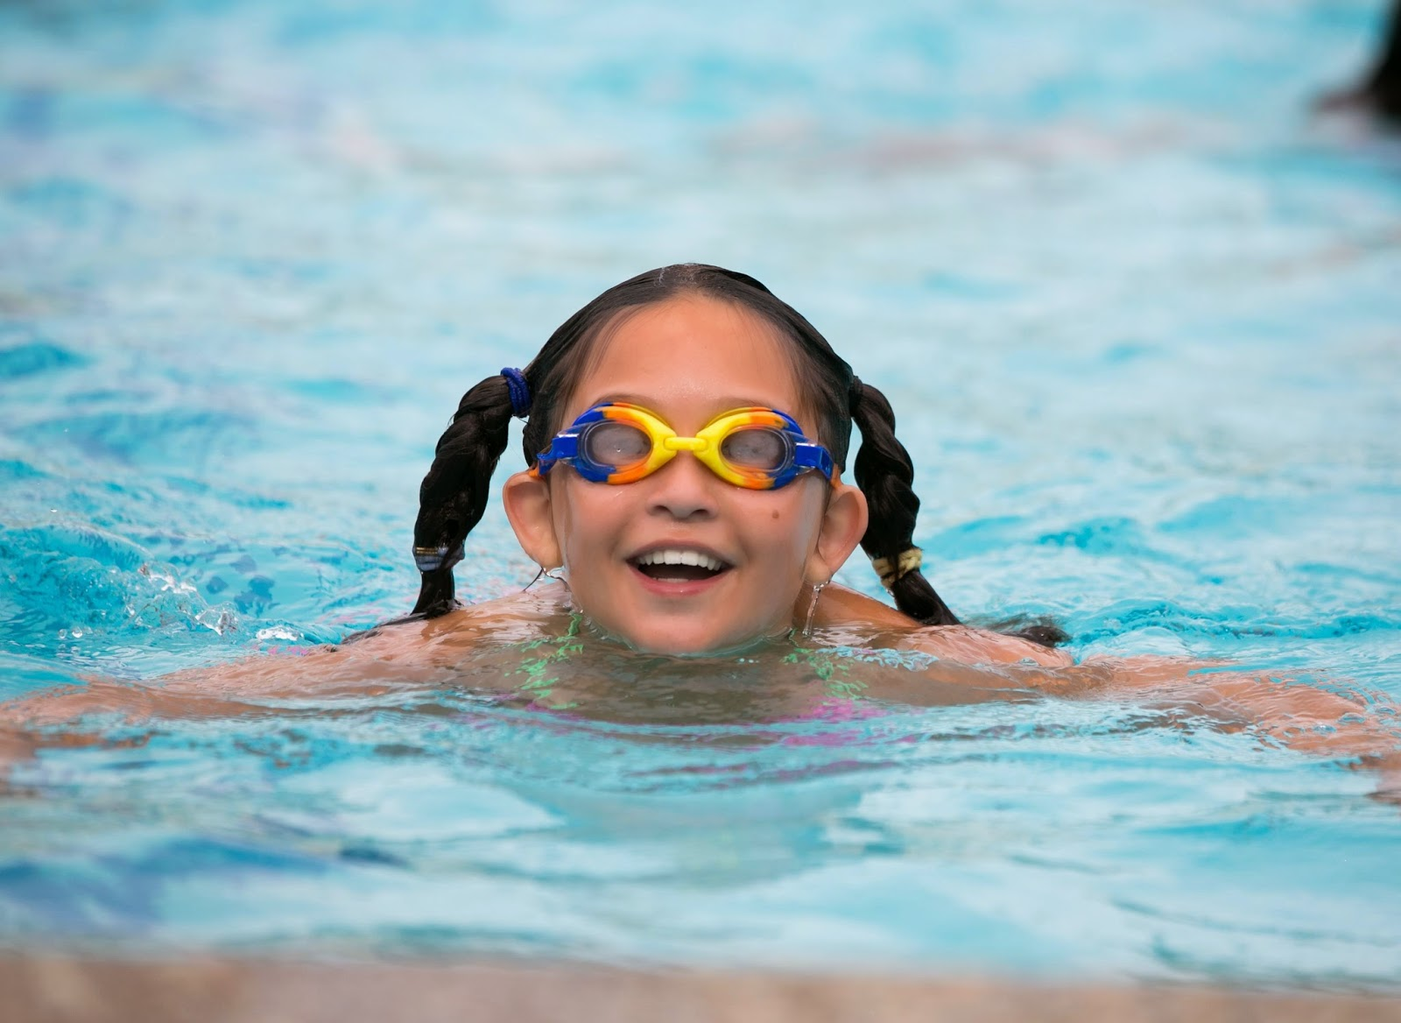
The Water Safety Code
Spot the dangers! Water may look safe, but it can be dangerous.
Learn to spot and keep away from dangers.
You may swim well in a warm indoor pool, but that does not mean that you will be able to swim in cold water.

Slide 3
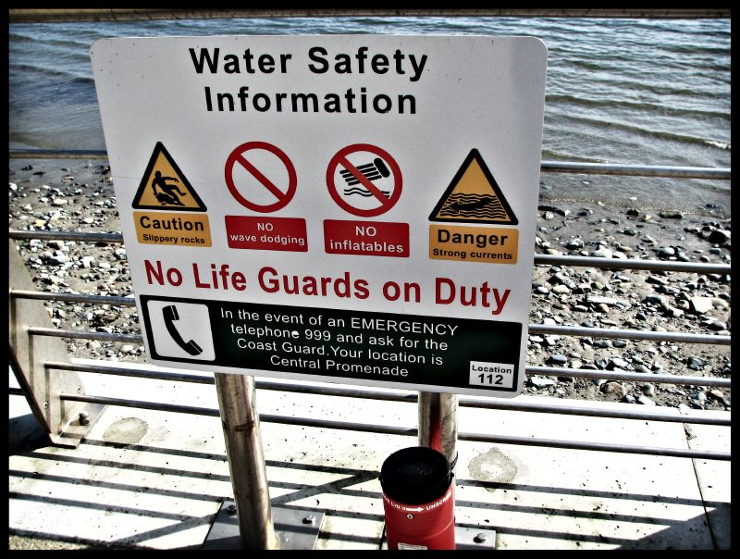
The dangers of water include:
Very cold temperatures
Hidden currents
It can be deep
It is difficult to estimate depth
There may be hidden rubbish like shopping trolleys or broken glass
It can be difficult to get out (steep slimy banks)
No lifeguards
Water pollution may make you ill

Slide 4
Read safety advice
Special flags and notices may warn you of danger
Know what the signs mean and do what they tell you

Slide 5
NO Swimming

Slide 6
Danger – Deep water

Slide 7
Danger – strong currents

Slide 8
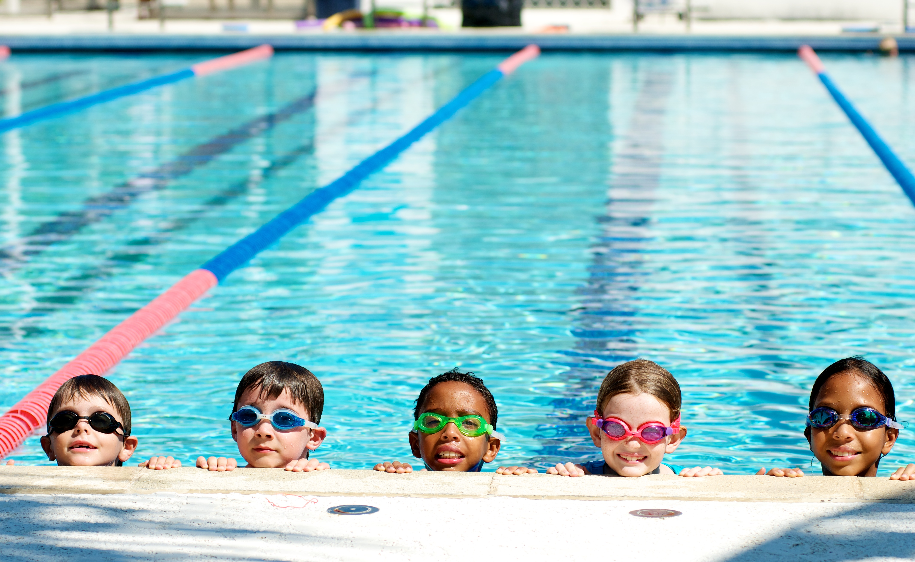
Go together
Children should always go with an adult, not by themselves.
An adult can point out dangers or help if somebody gets into trouble.
The safest place to swim is in a swimming baths

Slide 9
Learn how to help
You may be able to help yourself and others if you know what to do in an emergency.
If you see someone in difficulty, tell somebody, Shout help, preferably tell a Lifeguard if there is one nearby, or go to the nearest telephone, dial 999, ask for the police at inland water sites and the coastguard at the beach.

Slide 10
Keep safe
How can you do this?
Recap

