Slide 1


‘Clever Calculating’
‘Back to School’
at Park Hall Academy
# everyone can

Slide 2
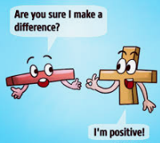
Children and adults find maths difficult because it is abstract. The CPA approach helps children learn new ideas and build on their existing knowledge by introducing abstract concepts in a more familiar way.
Concrete
Pictorial
Abstract

Slide 3
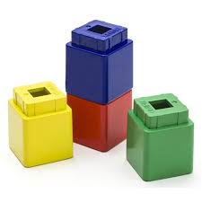
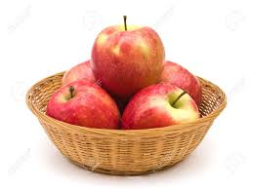
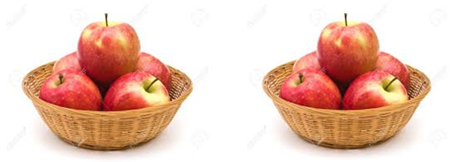
Concrete, Pictorial, Abstract
Concrete- this is the ‘doing’ stage, using concrete objects to model problems.
e.g. if a problem is about adding up four baskets of fruit, the children might first handle actual fruit before progressing to handling counters or cubes which are used to represent the fruit.

Slide 4
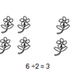
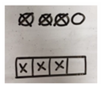

Concrete, Pictorial, Abstract
Pictorial- this is the ‘seeing’ stage, using representations of the objects to model problems.
e.g. building or drawing a model makes it easier to grasp concepts they traditionally find more difficult as it help them to visualise the problem.

Slide 5
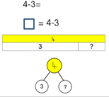
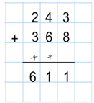
Concrete, Pictorial, Abstract
Abstract- this is the ‘symbolic’ stage, where children are able to use abstract symbols to model problems.

Slide 6
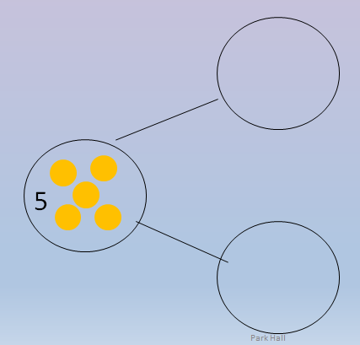
Part, part whole
Meet the part, part, whole model!
This will help children with number bonds and when solving addition and subtraction calculations.

Slide 7
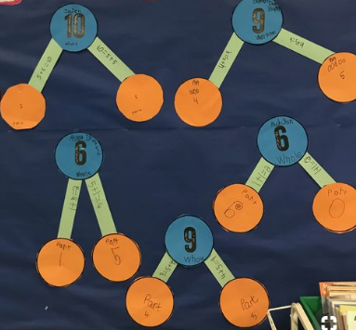
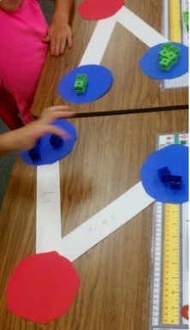
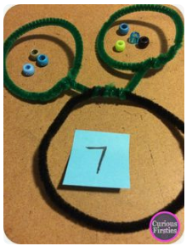
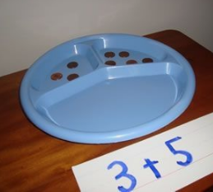

Slide 8
Now it is your turn!
Have a go at using the part, part whole model.
How many different ways can you make 20?
Notes:
Large paper on tables for parents and children to use to draw part, part whole.

Slide 9
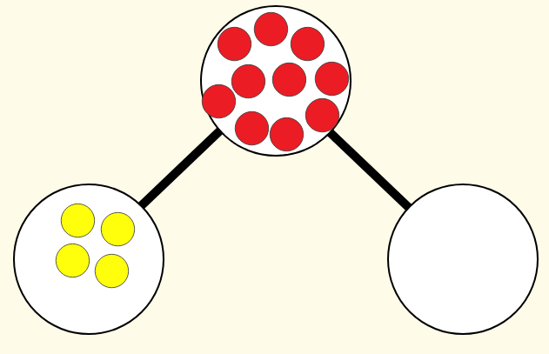
Next Step -
The whole and one part are given. Find the other part.
Children learn the relationship between addition and subtraction.
We always start by using real objects (concrete) before moving on to drawing the part, part, whole model.

Slide 10
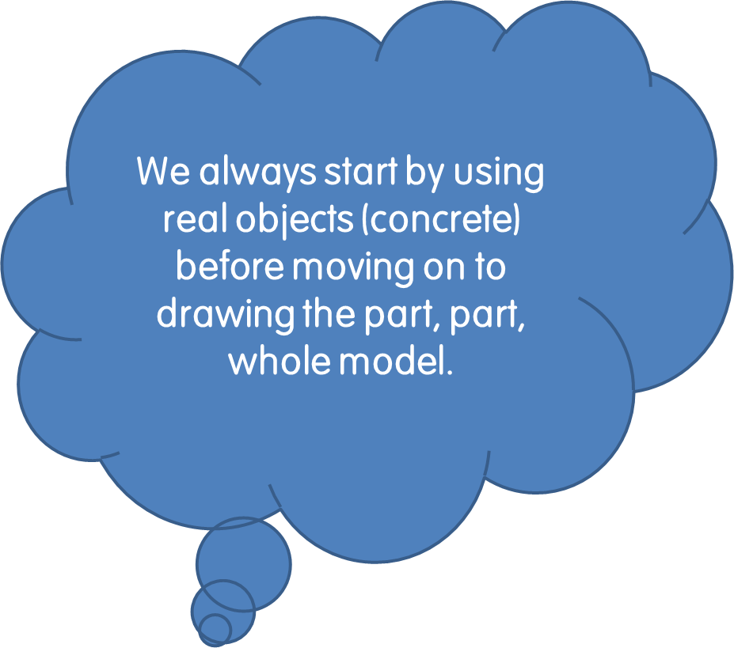
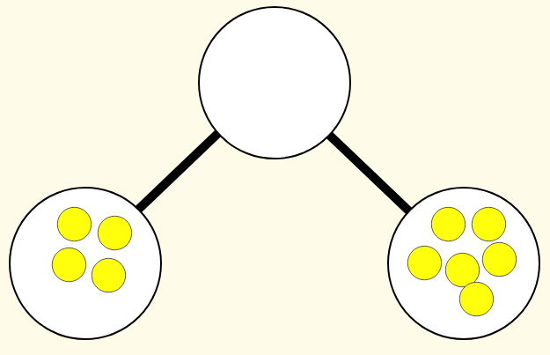
Next Step -
The parts are given - add together to find the whole.
When we understand, only then will we move on to recording using the abstract approach
6+4 = 10

Slide 11
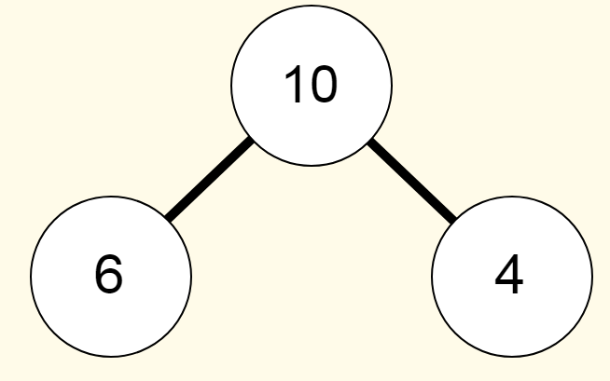
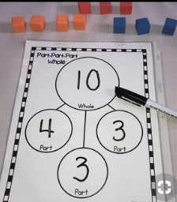
This helps children to see the relationship between addition and subtraction.
6+ 4 = 10 10= 4 + 6
4 + 6 = 10 10 = 6 + 4
10 – 4 =6
10 – 6 = 4
You can have more than two parts in the part whole method.

Slide 12
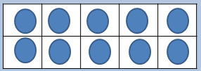
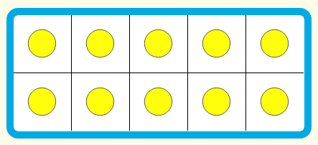
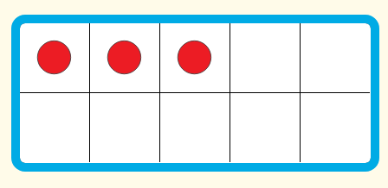
Ten Frames
Ten frames are used to help children to partition numbers and understand place value e.g.
13 = 10 + 3
A ten frame is a tool that allows children to see numbers.

Slide 13
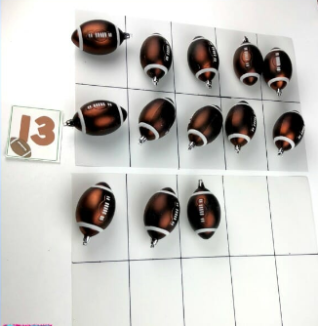
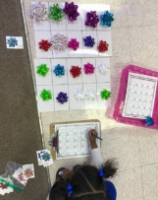
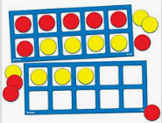
As with part, part whole, children begin using ten frames with real objects - the concrete stage.

Slide 14
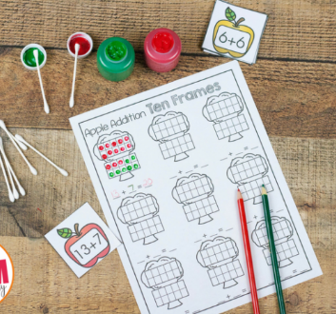
Next step
Children will move on to drawing their own representations on to a ten frame.
Here you can see the child is now solving an abstract calculation (13 + 7 ) using the ten frame and their knowledge of number facts .

Slide 15
Now your turn!

Slide 16
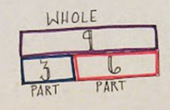

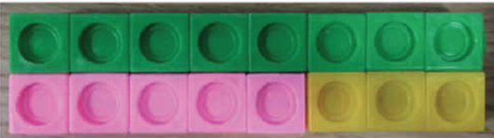
Bar modelling
Bar modelling is a strategy to help pupils to reason a problem before solving it.
A bar model will not give you the answer but it helps you to visualise and reason a problem.

Slide 17
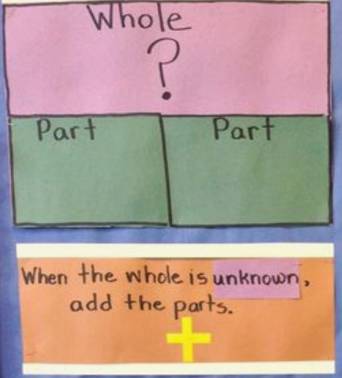
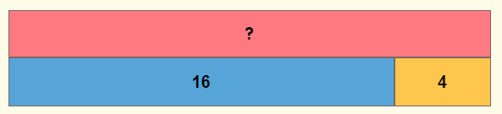
Here are some typical representations of bar models.

Slide 18
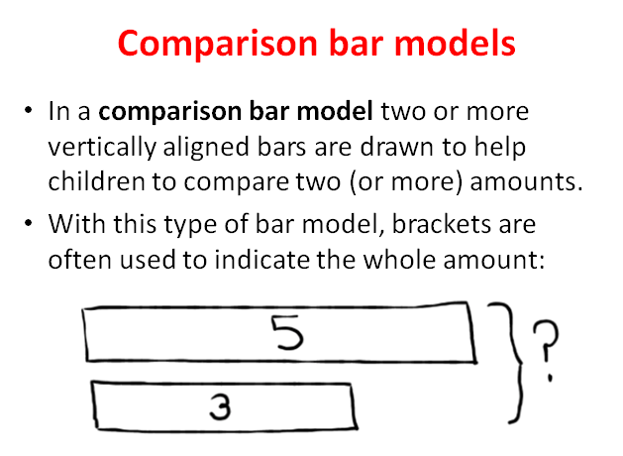

Slide 19
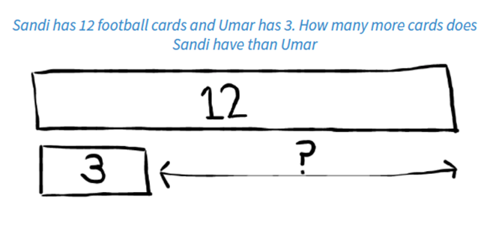

Slide 20
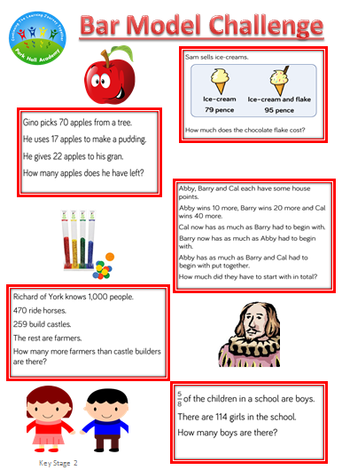
Clever Calculating
Your turn !
Please continue your learning together at home together!
Remember to use all of the concrete, pictorial and abstract methods that you have seen today to solve the problems.
You may go in to the pit, but remember marvellous mistakes are how we learn!
Please tweet us (@AcademyParkHall) photos of you continuing your learning journey at home.

Slide 21
Look out for our ‘Clever Calculation’ tweets and ‘Bar-vember’ bar models.
Please tweet us @AcademyParkHall pictures of you and your family enjoying the home learning activity.
All tweets will be entered in to a prize draw – you must be in it to win it!

