Slide 1


‘Clever Calculating’
‘Back to School’
at Park Hall Academy
# everyone can

Slide 2

Children and adults find maths difficult because it is abstract. The CPA approach helps children learn new ideas and build on their existing knowledge by introducing abstract concepts in a more familiar way.
Concrete
Pictorial
Abstract

Slide 3
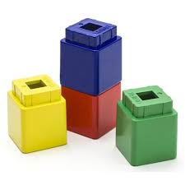
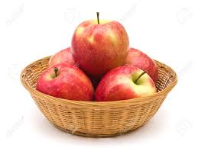
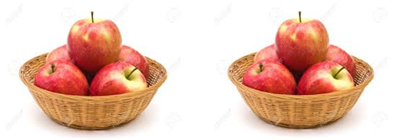
Concrete, Pictorial, Abstract
Concrete- this is the ‘doing’ stage, using concrete objects to model problems.
e.g. if a problem is about adding up four baskets of fruit, the children might first handle actual fruit before progressing to handling counters or cubes which are used to represent the fruit.

Slide 4
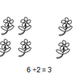
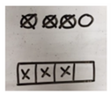

Concrete, Pictorial, Abstract
Pictorial- this is the ‘seeing’ stage, using representations of the objects to model problems.
e.g. building or drawing a model makes it easier to grasp concepts they traditionally find more difficult as it help them to visualise the problem.

Slide 5
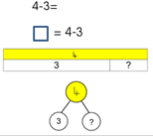
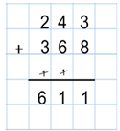
Concrete, Pictorial, Abstract
Abstract- this is the ‘symbolic’ stage, where children are able to use abstract symbols to model problems.

Slide 6
Your turn!
32 + 14 =
123 + 64 =
Challenge – 329 + 531 =

Slide 7
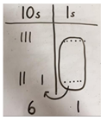
Pictorial
This is how the children will first begin to record their calculations before moving on to the abstract.
Key Vocabulary: regrouping, exchanging, tens, ones

Slide 8
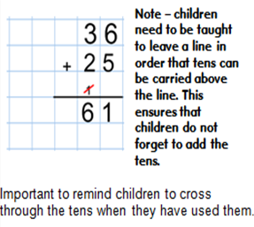
Abstract
Please ensure that you follow this same approach when working with your child. A consistent approach will support children.
32 + 14 =

Slide 9
Bar modelling
Bar modelling is a strategy to help pupils to reason a problem before solving it.
A bar model will not give you the answer but it helps you to visualise and reason a problem.

Slide 10
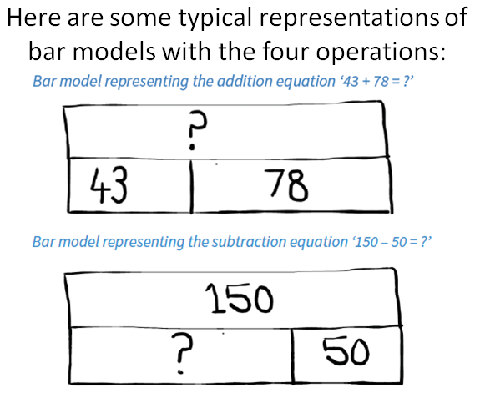

Slide 11
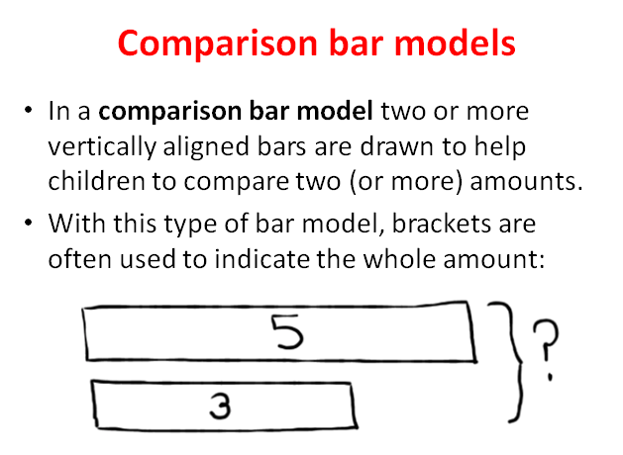

Slide 12
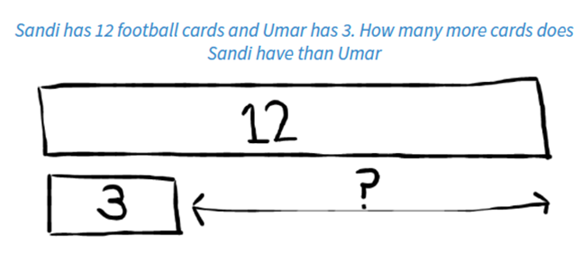

Slide 13
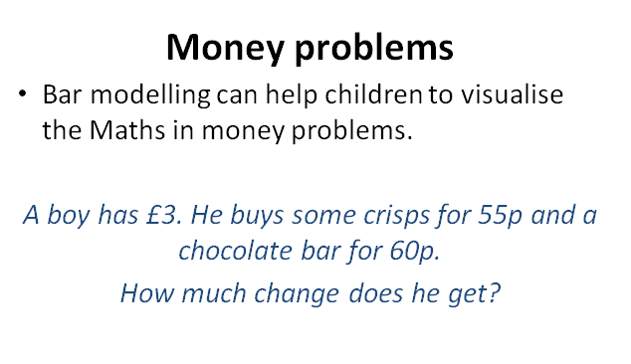
Have a go at drawing this problem in a bar model!

Slide 14
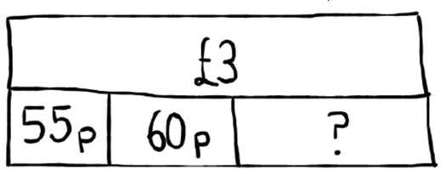

Slide 15
90 sweets are shared between bowls a, b and c. Bowl b contains twice the amount that bowl a contains. Bowl c contains three times the amount that bowl a contains. How many more sweets does bowl b have than bowl a?
These are the types of problems that children are expected to solve in NCT’s. Bar modelling provides a strategy to use.

Slide 16
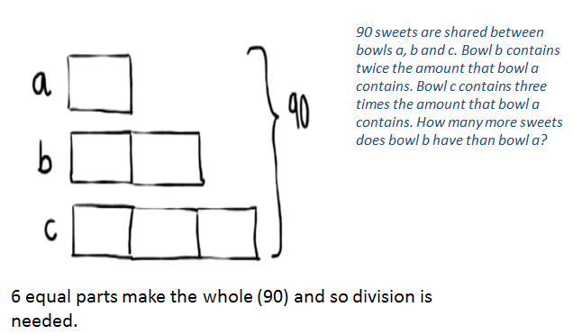
We can see that there are 6 parts – 90 ÷ 6 = 15
Each part equals 15,
30-15 =15

Slide 17
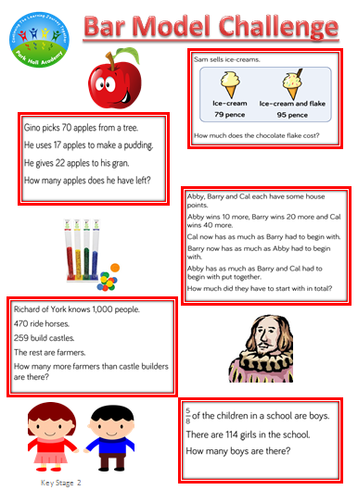
Clever Calculating
Your turn !
Please continue your learning together at home together!
Remember to use all of the concrete, pictorial and abstract methods that you have seen today to solve the problems.
You may go in to the pit, but remember marvellous mistakes are how we learn!
Please tweet us (@AcademyParkHall) photos of you continuing your learning journey at home.

Slide 18
Look out for our ‘Clever Calculation’ tweets and ‘Bar-vember’ bar models.
Please tweet us @AcademyParkHall pictures of you and your family enjoying the home learning activity.
All tweets will be entered in to a prize draw – you must be in it to win it!

